Slide 1


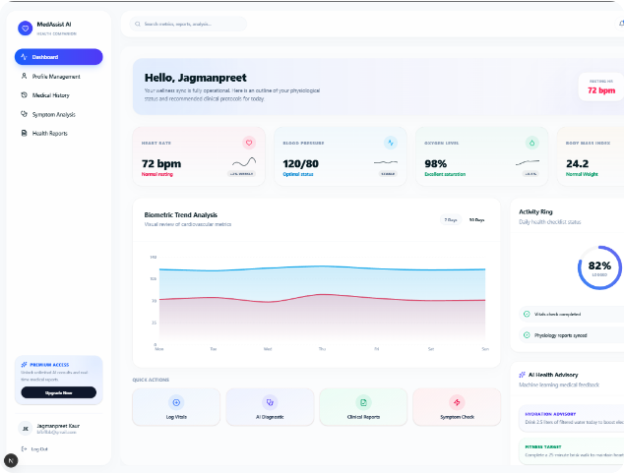




Next-Gen AI
Healthcare Companion
An intelligent multi-tier platform built to synthesize patient biometrics, symptom reports, and clinical history for early triage and diagnostic support.
Real-Time Vitals Dashboard
Continuous monitoring of cardiovascular metrics, oxygen levels, and biometric trend analysis.
Enterprise Infrastructure
FastAPI microservices, Next.js 14 frontend, JWT RBAC security, and dual database architecture.
PostgreSQL + Mongo Dual Persistence Layer
JWT Auth & RBAC Role Access Control
Confidential • Investor & Academic Evaluation
Slide 1 of 6

Slide 2

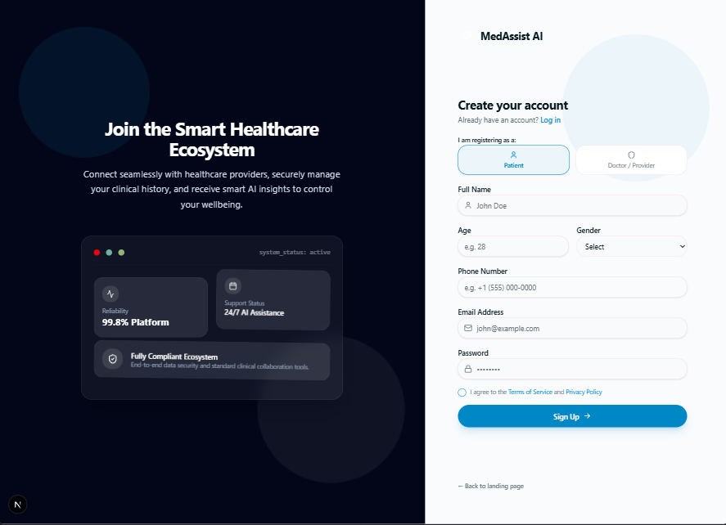






Role-Based Auth & Secure Access Control
Strict compliance-ready authentication isolating Patient and Doctor permissions via encrypted JWT tokens.
Dual-Role Access Control (RBAC)
Distinct authentication workflows and portal views designed specifically for Patients and Healthcare Providers.
Bcrypt Hashing & JWT Tokens
Industry-standard password encryption with stateless JSON Web Tokens powering fast API authorization.
Structured Patient Intake
Collects essential demographical data (Age, Gender, Contact) needed for precision AI medical risk profiling.
MedAssist AI Architecture
Slide 2 of 6

Slide 3
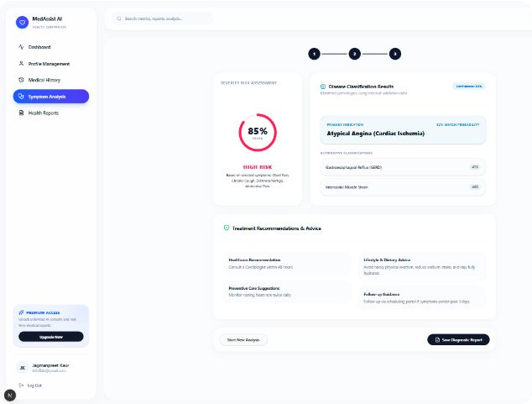
Symptom Analysis & AI Risk Engine
Interactive diagnostic workflow evaluating patient symptom severity and calculating pathology probabilities.
Severity Risk Index Assessment
Quantifies risk score based on symptom duration, severity, and modifying factors (e.g., 85% High Risk Index).
Pathology Probability Classifier
Matches symptom vectors against primary indications (e.g. Atypical Angina) with secondary differential matches.
Actionable Treatment Guidance
Provides immediate healthcare recommendations, lifestyle adjustments, and follow-up guidance.
MedAssist AI Clinical Triage
Slide 3 of 6

Slide 4
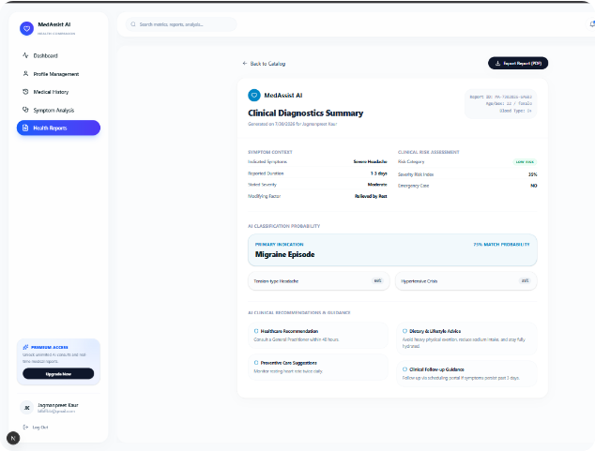

Clinical Diagnostics & Health Report Export
Automated generation of structured medical reports for patient record keeping and physician consultation.
Instant PDF Report Export
One-click compilation of clinical diagnostics summaries ready for physician review or EHR attachment.
Comprehensive Symptom Context
Tracks duration, stated severity, and relieving factors alongside match probabilities (e.g., 75% Migraine Episode).
Preventive Care Roadmap
Includes personalized lifestyle, dietary, and preventive guidance tailored to specific diagnostic results.
MedAssist AI Health Reports
Slide 4 of 6

Slide 5
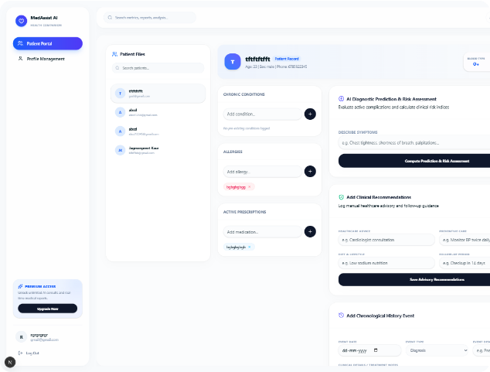
Physician Dashboard & Patient Management
A centralized clinical workspace enabling doctors to evaluate patient files, log conditions, and trigger AI risk predictions.
Patient Files Integration
Instant lookup of patient profiles, blood type, body metrics, chronic conditions, and active allergies.
Active Prescription Tracking
Manage medical prescriptions, log pre-existing conditions, and track patient-reported allergic reactions.
AI Prediction & Advisory Logging
Compute real-time risk assessments directly from physician symptom descriptions and save advisory notes.
MedAssist AI Provider Portal
Slide 5 of 6

Slide 6
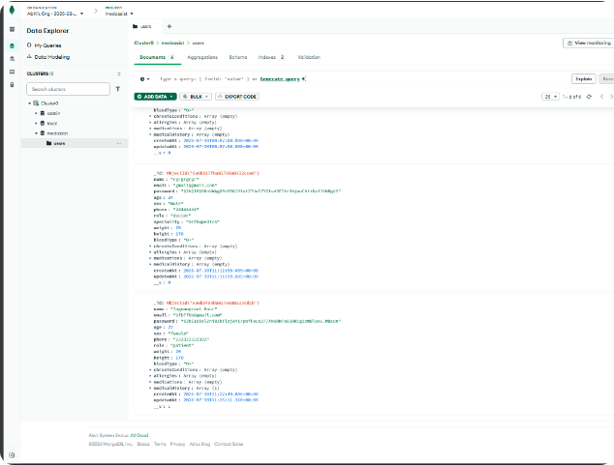
Database Schema & Live Data Verification
Demonstrating verified document storage, hashed credentials, user roles, and medical history arrays in MongoDB Atlas.
Flexible MongoDB Document Schema
Stores rich patient & doctor records, including body metrics (weight, height, bloodType) and nested medical history arrays.
Role-Based Data Security
Distinguishes "patient" and "doctor" roles seamlessly while securing authentication credentials with bcrypt password hashing.
Milestone 1 Backend Operational
Verified end-to-end data flow: user registration, triage entries, and clinical updates correctly persist in the medassist cluster.
MedAssist AI Milestone 1 Final
Slide 6 of 6

